Slide 1
How to Build Trust Into 5G:
Final Presentation
Rahul Muthyam, Benjamin Stark, Gandhar Joshi, Marlon Schumacher, Nikhil Joshi

Slide 2
Introduction
5G is moving to a decentralized, autonomous network architecture
Decentralization involves sharing parts of 5G’s infrastructure with third parties
  Need a security system to verify the trust of the third parties
Remote attestation may be the solution
  Protocol asks device to send info to verifying agent
  Agent verifies device’s integrity based on info
Notes:
Marlon

Slide 3
Initial Goals
Figure out how to implement mutual remote attestation into 5G network
Figure out how to implement attestation in roaming/handover use case
Notes:
Marlon

Slide 4
Initial Team Approach
We are using Docker + Open5GS + UERANSIM testbed
  Simulates the 5G network
  Used to implement workflows and protocols into 5G
We are using Wireshark to collect network information
Final product will be implementation of existing attestation protocol workflow in handover/roaming scenario
  Should work smoothly and securely in decentralized 5G network
  Should guarantee accurate verification of trust
Notes:
Marlon

Slide 5
Changes In Goals
Completing attestation protocol design and implementation in testbed was estimated to take longer than expected
  Our team had little experience with 5G
Our initial protocol was redesigned due to new findings
Shifted focus to just describing a full protocol for attestation in N2 handover using diagrams
Notes:
Benjamin

Slide 6
New Team Approach
Research N2 handover scenario and determine how to design a protocol for implementing mutual attestation to the scenario
Create diagrams and descriptions detailing our protocol’s design
Notes:
Benjamin

Slide 7
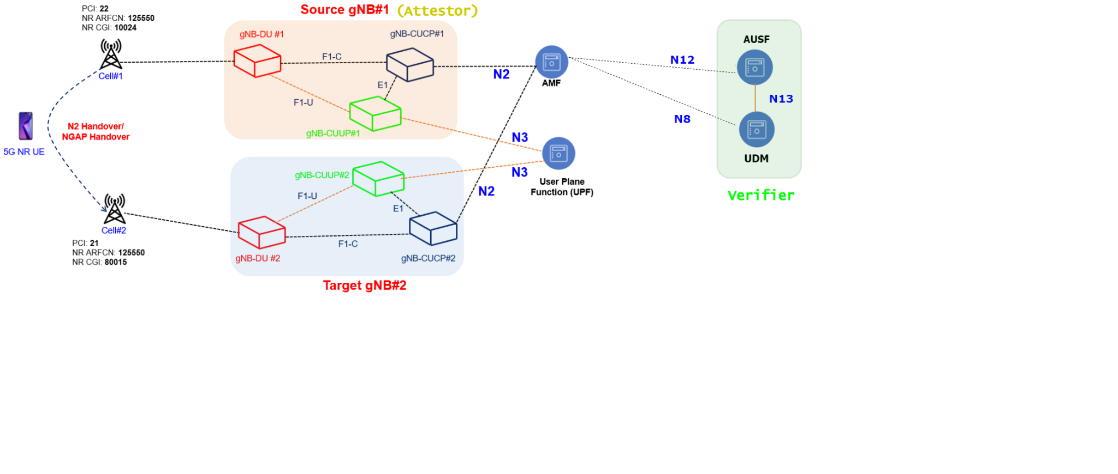
N2 Handover Procedure
Notes:
Gandhar

Slide 8
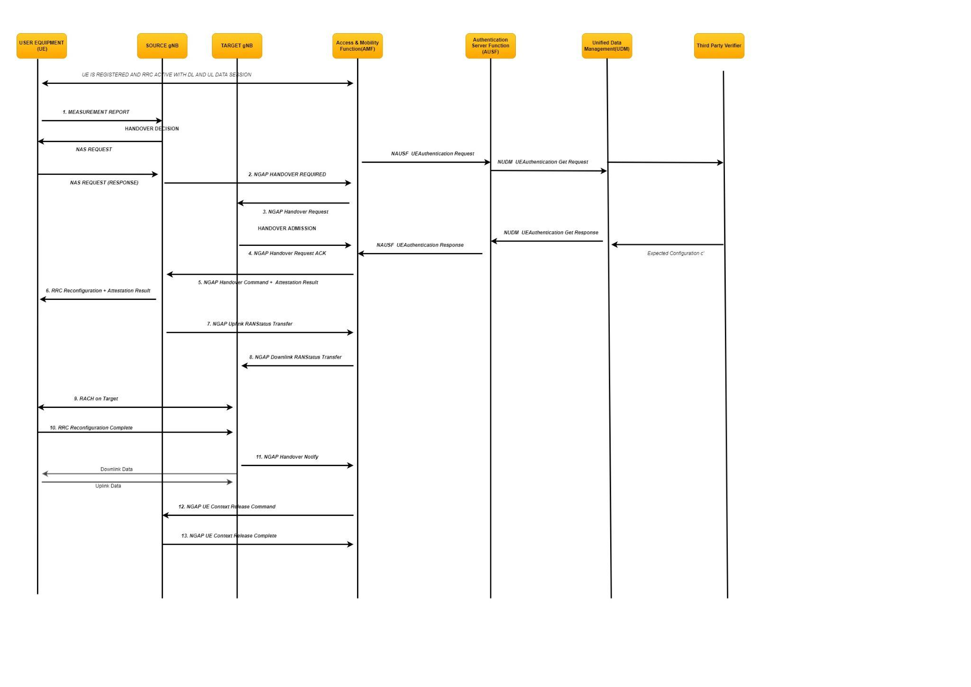
N2 Handover with Remote Attestation Workflow
Notes:
Gandhar

Slide 9
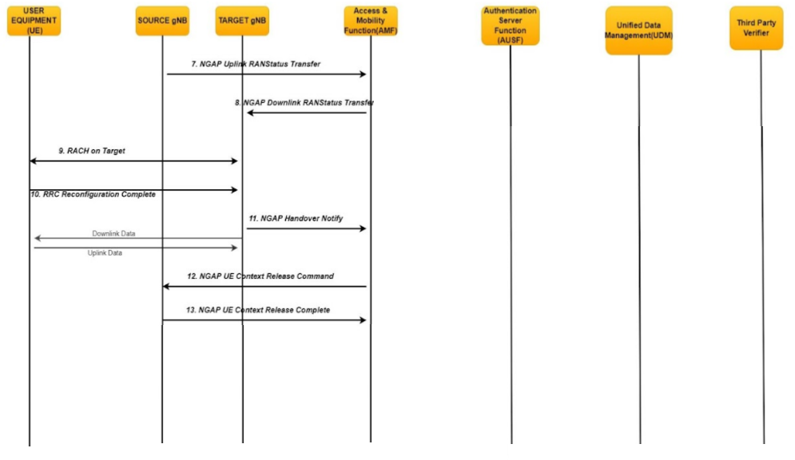
N2 Handover with Remote Attestation Workflow (Cont.)
Notes:
Gandhar

Slide 10
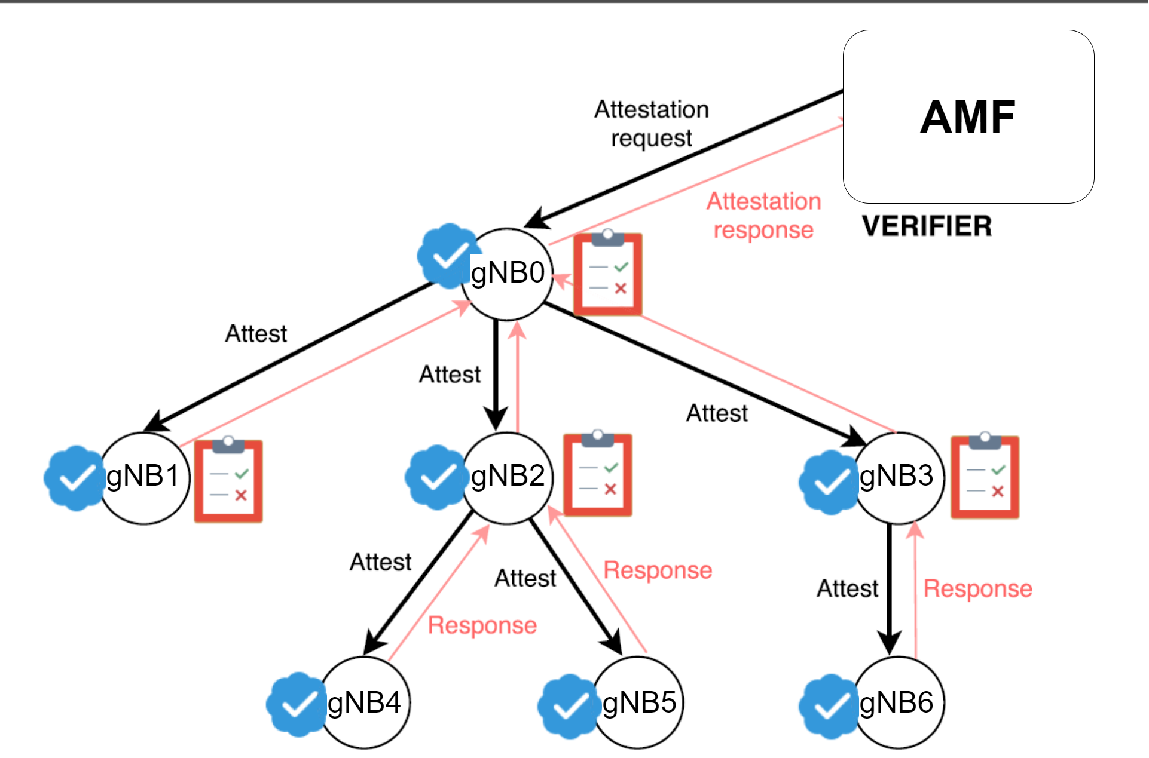
The SEDA Protocol
Notes:
Nikhil

Slide 11
Conclusions
We researched potential attestation protocols to use in 5G
We set up a test bed to simulate a 5G network and test implementations of the protocols
We realized designing and implementing attestation required a lot more time
  So we focused on completing the design of the attestation in one use case: N2 Handover
Notes:
Nikhil

Slide 12
Future Plans
Map functionalities from handover diagrams to testbed implementation
Implement handover scenario into testbed
Implement attestation protocols into handover use case
Migrate the testbed from Docker to Kubernetes
Report on our research findings
Notes:
Nikhil

Slide 13
Questions?
Notes:
Rahul

